Slide 1
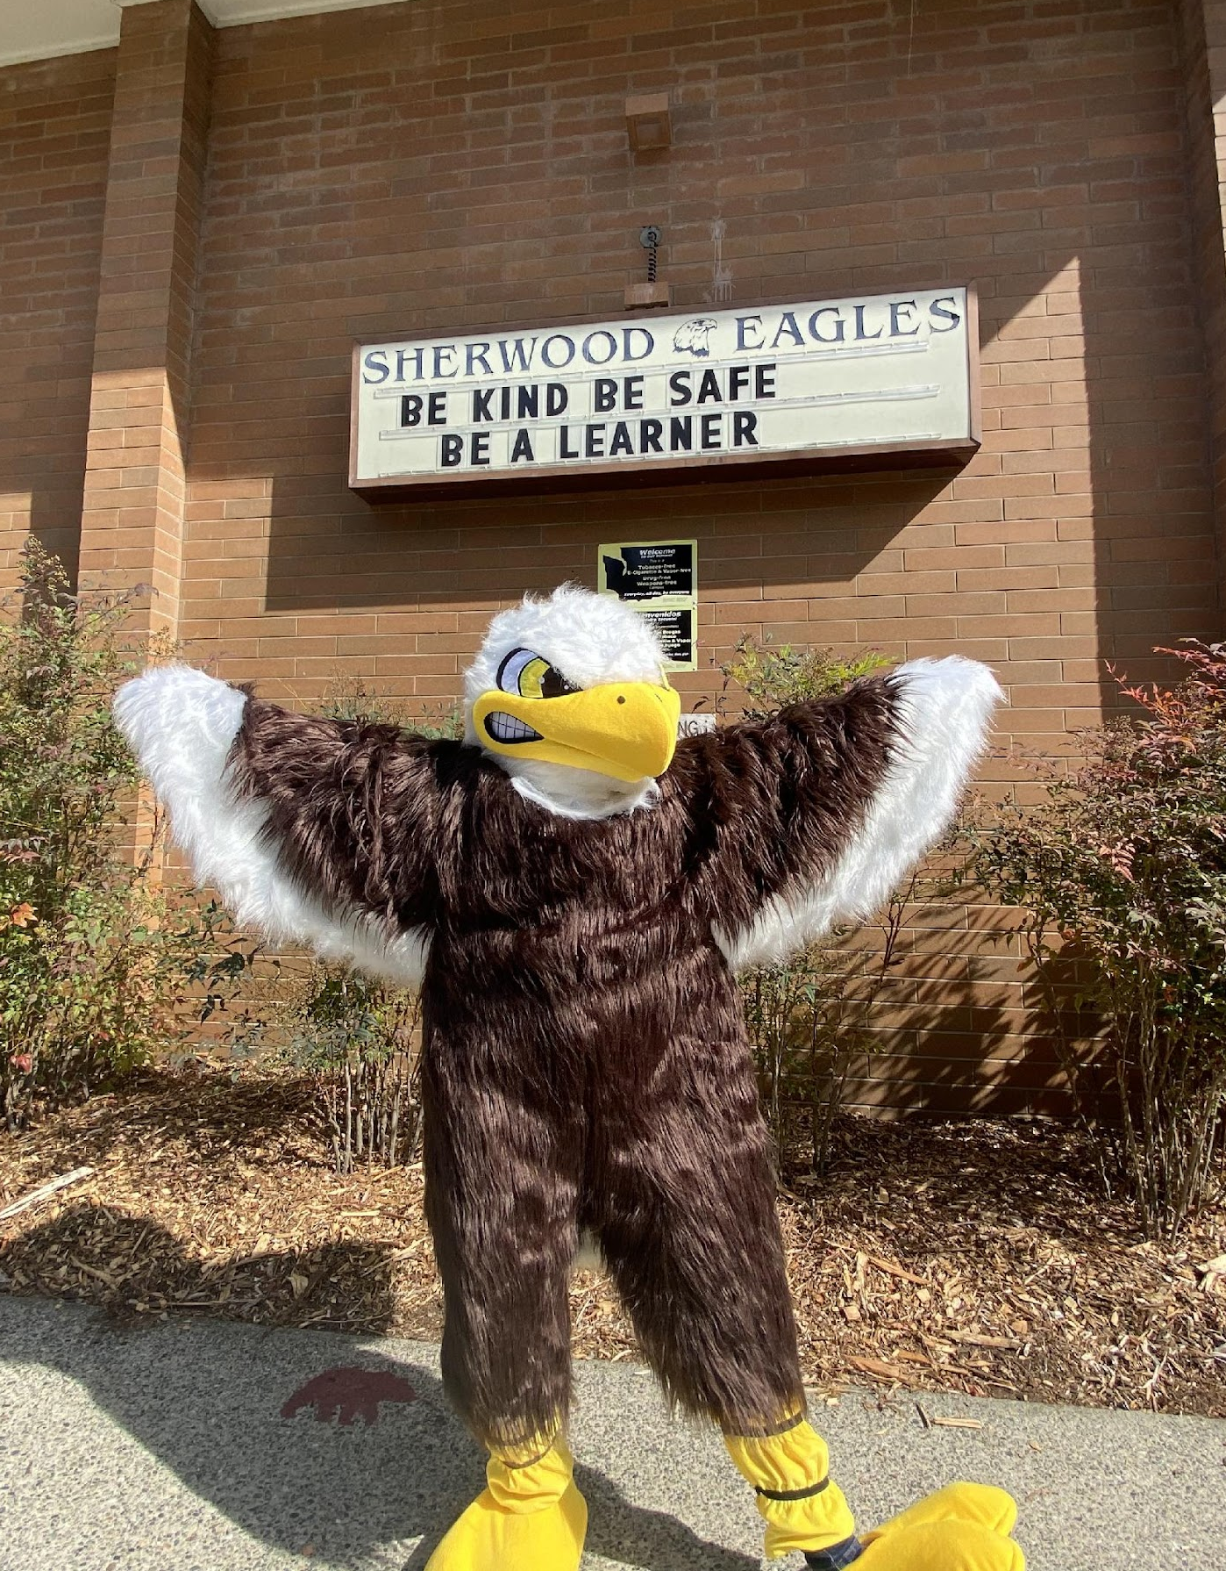
Sherwood Elementary
PSO MEETING # 2
NOVEMBER 10, 2021

Slide 2
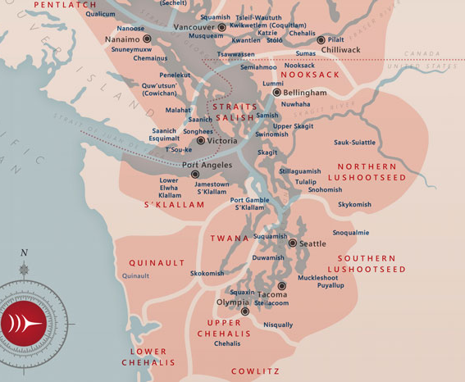
Land acknowledgement
We respectfully acknowledge that our meeting is being held on the traditional lands of the Coast Salish Peoples, in particular Tulalip, Snohomish, Stillaguamish, and Sauk-Suiattle Tribes.

Slide 3
Meeting Agenda
Approve Minutes from September 29th Board Meeting
Review PSO By Laws
PSO Budget Approval
Walkathon Wrap Up
Winter Fundraiser
Principal Update - Sherwood Elementary School Improvement Plan

Slide 4
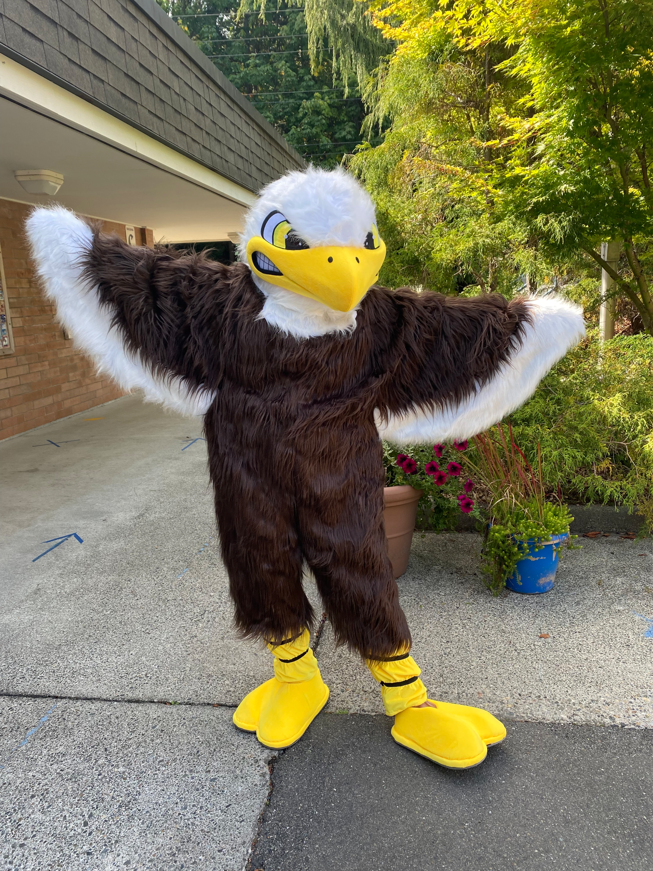
Approve minutes
Notes:
PSO General Board Meeting Notes 9_29_21.docx - Google Docs
Link to minutes from September 29th meeting

Slide 5
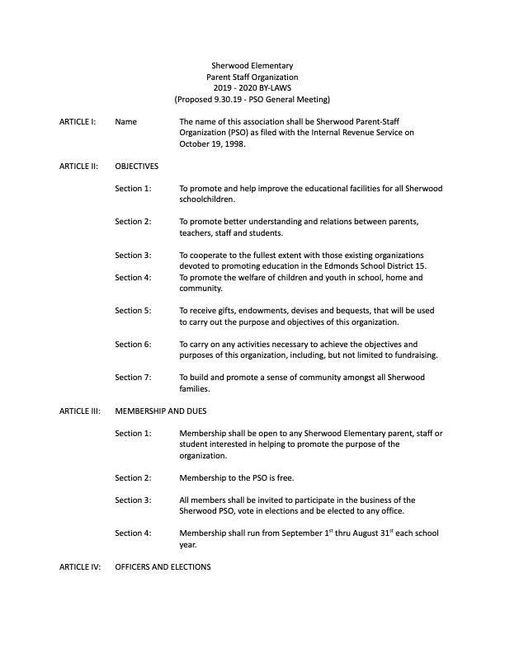
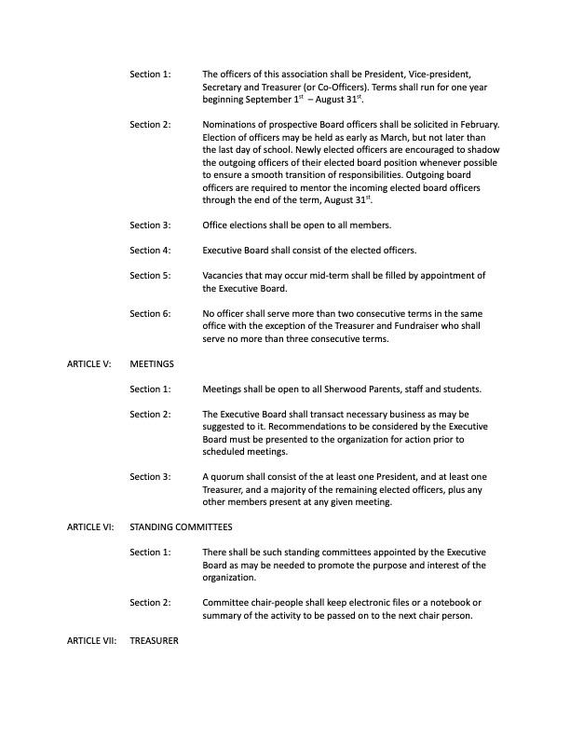
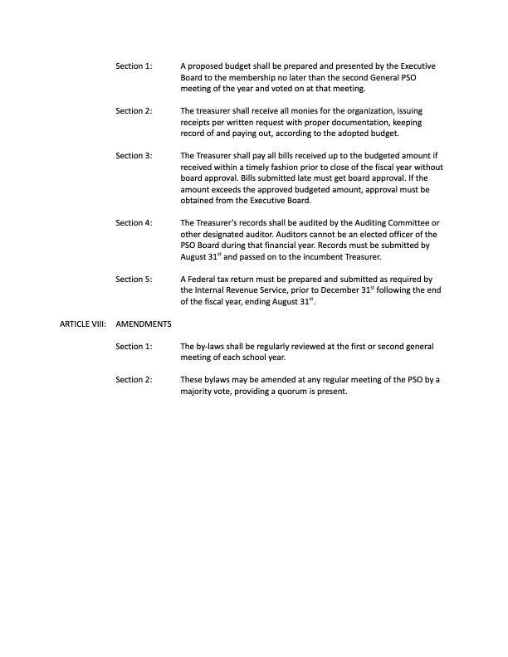
Review PSO By Laws
Notes:
Link to by laws: https://docs.google.com/document/d/1HDPIqwMDl8rdHBeGE88iPsE3nsQMZOhv/edit?usp=sharing&ouid=103772217047796064643&rtpof=true&sd=true

Slide 6
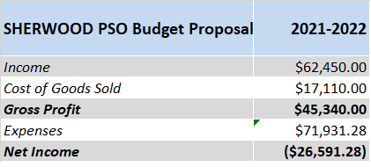
PSO Budget Summary
We are budgeting a negative Net Income because PSO was unable to spend its entire 2020-2021 budget given school closures and event restrictions during the ongoing pandemic.
2021-2022 fundraisers include Walkathon, Winter Auction (in lieu of Wreaths), Cookie Dough Sales, Book Fair, Math Team, Box Tops and Amazon Smile.

Slide 7
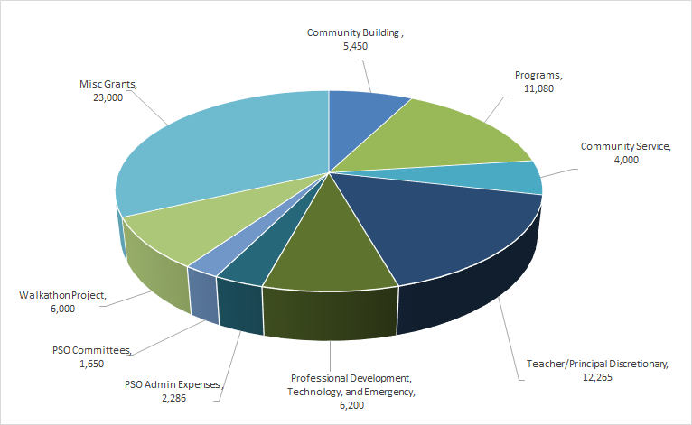
PSO Budgeted Expenses
Community Building
Programs
Community Service
Teacher/Principal Discretionary
Professional Development, Technology, and Emergency
PSO Admin Expenses
PSO Committees
Walkathon Project
Misc Grants

Slide 8
PSO Budget Approval
Voting for the Budget
All those in favor of approving the proposed 2021-2022 budget, type 'yay' in your chat column.
All those opposed to approving the proposed 2021-2022 budget, type 'nay' in your chat column.

Slide 9
Walkathon Wrap Up
Thank you to the amazing Walkathon Committee, Ms. Thain, and all of the families, teacher and staff who made this year’s walkathon a HUGE success even though it needed to look a little different!
Thanks to you, our school was able to raise $42,000, including the money from our sponsors!
Nine different classrooms won a classroom experience (such as cozy sock and show day, glow stick dance party and ice cream party)
All classrooms earned Tier 1 (Sherwood Eagle stickers) and Tier 2 (silicone bracelets) and 8 classrooms won the Tier 3 pizza coupon prize
Our top 3 fundraising classrooms will be choosing an all class spirit day and will get to select Sherwood Eagle names for the school to vote on!

Slide 10
Sherwood Holiday Community Auction
Virtual Holiday Auction on Rally Up
11/29 - 12/2
Opportunity to support Sherwood and the local businesses
Focus is on fundraising (different from walkathon which is fundraising and community building)
More communication week of Thanksgiving

Slide 11
Stay Connected!
Family Directory
Class Parent Communication
PSO Facebook Group
PSO Monthly Newsletters
PSO Website

Slide 12
Questions?

Slide 13
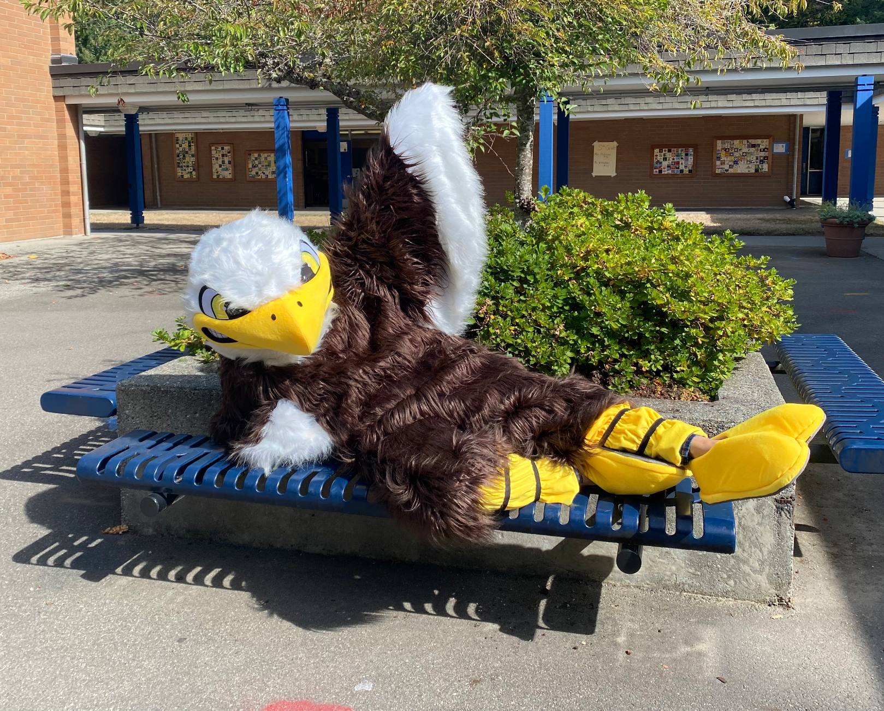
Principal Update
Welcome our Sherwood principal, Robyn Saltzman!
School Improvement Plan

Slide 14
Questions?

Slide 15
Thank you for joining us!
PLEASE JOIN US AT OUR NEXT GENERAL PSO MEETING IN MARCH 2022!

